Slide 1


Capstone Project: Business Expansion
Opening a new branch in South London

Slide 2


Contents
Introduction
Data Requirements
Methodology
Results / Discussion
Conclusion

Slide 3
Introduction
Recommendation required for a new branch location for a successful business located in Bedminster, Bristol, UK
Business has already determined that new branch should be in South London
Business believes that the type of people who frequent other venues in the Bedminster area are key to the success of a the business

Slide 4
Data Requirements
South London
A list of postcode areas and associated neighbourhood names (found through doogal.co.uk)
Details of latitude and longitude data for South London postcodes (found through London government website)
A list of nearby venues for each South London postcode area (accessible through Foursquare)
Bedminster
A list of nearby venues around Bedminster (accessible through Foursquare)

Slide 5
Data Requirements – data cleaning
Data cleaning was required for South London data
Initial latitude/longitude data contained details for over 69,000 individual postal codes
The detail of individual postal codes were dropped, only retaining the post code area
This was then summarised to give a centrepoint for each postcode area, as defined in the neighbourhoods data, resulting in 46 rows of latitude and longitude data
The location data and the neighbourhoods data was then combined to form a single dataframe with all the information about South London areas.

Slide 6
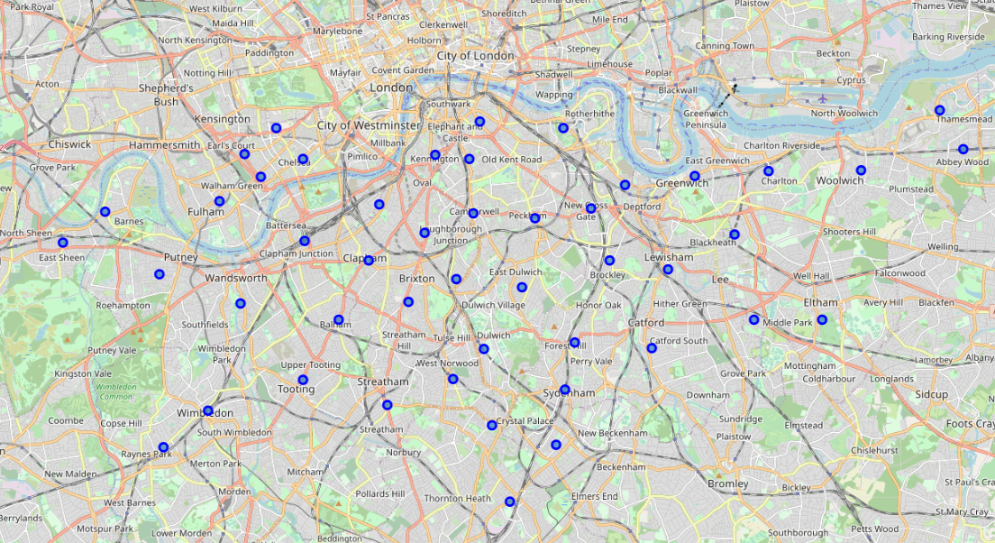
Methodology
Combined location and neighbourhood data was used to create a map, showing the location of each of the South London neighbourhoods which would be explored as a potential new location for the business.

Slide 7
Methodology
The South London neighbourhoods were explored using Foursquare
The most common venues were presented in a table, a portion of which is below
Neighbourhood | 1st Most Common Venue | 2nd Most Common Venue | 3rd Most Common Venue | 4th Most Common Venue | 5th Most Common Venue | 6th Most Common Venue | 7th Most Common Venue | 8th Most Common Venue | 9th Most Common Venue | 10th Most Common Venue | 11th Most Common Venue | 12th Most Common Venue | 13th Most Common Venue | 14th Most Common Venue | 15th Most Common Venue
Abbey Wood | Supermarket | Platform | Campground | Soccer Field | Grocery Store | Train Station | Historic Site | Coffee Shop | Electronics Store | Farmers Market | Food Truck | Food Stand | Diner | Food Court | Food & Drink Shop
Anerley, Penge | Pub | Grocery Store | Pizza Place | Supermarket | Train Station | Fast Food Restaurant | Park | Coffee Shop | Hardware Store | Café | Track Stadium | Italian Restaurant | Gas Station | Hotel | Farm
Balham | Coffee Shop | Pub | Bakery | Grocery Store | Pizza Place | Indian Restaurant | Bar | Italian Restaurant | Supermarket | Gym / Fitness Centre | Sandwich Place | Café | Physical Therapist | Hotel | Park
Barnes, Castelnau | Pub | Park | Restaurant | Coffee Shop | Grocery Store | Farmers Market | Harbour / Marina | Convenience Store | Pizza Place | Café | Platform | Food & Drink Shop | Movie Theatre | Sports Club | French Restaurant
Battersea, Clapham Junction | Pub | Bakery | Café | Coffee Shop | Cocktail Bar | Italian Restaurant | Indian Restaurant | Bar | Portuguese Restaurant | Pizza Place | Grocery Store | Supermarket | Gym / Fitness Centre | French Restaurant | Thai Restaurant

Slide 8
Methodology
Bedminster was also explored using Foursquare, and along with the South London data, the venue data was normalised to allow for comparisons between neighbourhoods.
K-Means clustering was then run on the whole dataframe, grouping the neighbourhoods into 10 clusters, based on the frequency of venues in those neighbourhoods.
The South London neighbourhoods which were clustered with Bedminster were then extracted and plotted on another map.

Slide 9
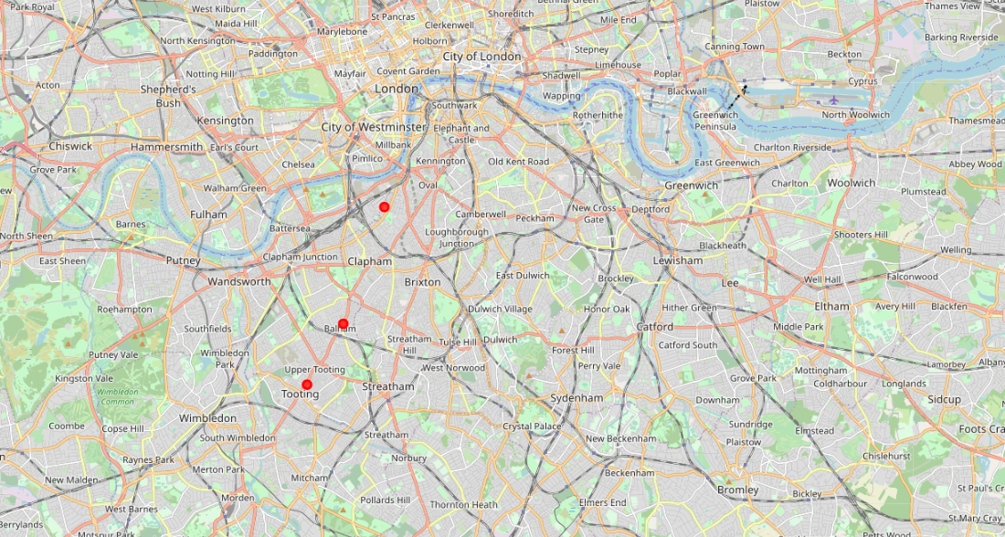
Results
The three South London neighbourhoods which were clustered with Bedminster in the K-Means Clustering were:
Nine Elms, South Lambeth (SW8)
Balham (SW12)
Tooting (SW17)

Slide 10
Discussion
A major challenge for this project was the comparatively low popularity of Foursquare in the UK, and hence the lack of venues which are populated in the Foursquare database, particularly for Bristol
This means that the Bedminster data was very sensitive, due to the small number of venues returned
However it does appear that there is still a good match between the clustered neighbourhoods and Bedminster, reviewing the “most common venues” tables, backed up with local knowledge of the Bedminster area.

Slide 11
Conclusion
Despite the relative lack of Foursquare data for Bedminster, it has been possible to successfully compare to South London neighbourhoods
The recommendation to the business owner is that the best neighbourhoods to open another branch of the business in are Balham(SW12), Tooting (SW17), or Nine Elms, South Lambeth (SW8).
These neighbourhoods are in a relatively common geographic location and may now be further considered by the business owner to review any other limitations or benefits of these areas.

